Slide 1
SPI Driver on Linux
Author: Nguyen Trong Dung
Mail: nguyentrongdung0498@gmail.com

Slide 2
Agenda
Introduction to SPI
SPI concepts on Linux
Demo SPI protocol driver with LCD Nokia 5110

Slide 3
Introduction to SPI
What's SPI?
SPI signals
SPI Modes

Slide 4
What's SPI?
Stand for Serial Peripheral Interface
Protocol uses 4 wire signals
Designed by Motorola
Master and Slave

Slide 5
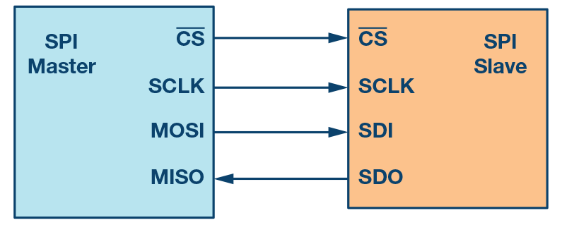
SPI signals
CS: chip select
SCLK: Clock
MOSI: Master out Slave in
MISO: Master in Slave out

Slide 6
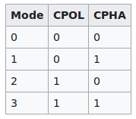
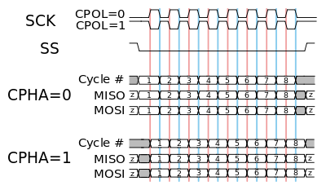
SPI Modes

Slide 7
SPI concepts on Linux
SPIDEV driver
SPI protocol driver
SPI controller driver

Slide 8
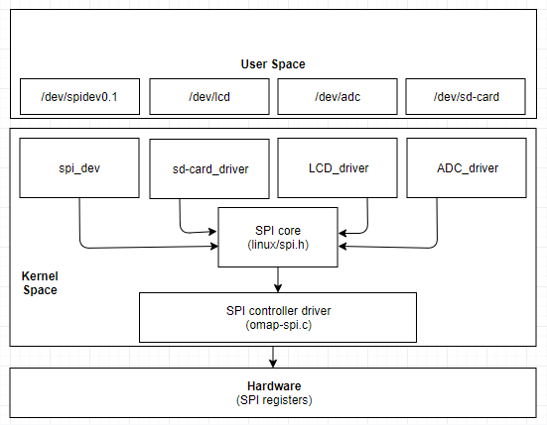
SPI concepts on Linux

Slide 9
SPIDEV
Idea
Simplest for development and test
Enable spidev
drivers/spi/spidev.c

Slide 10
SPI protocol driver
Idea: Support functions with special device
#include <linux/spi.h>

Slide 11
Implement SPI protocol driver
Device tree
Register struct spi_driver with kernel.

Slide 12
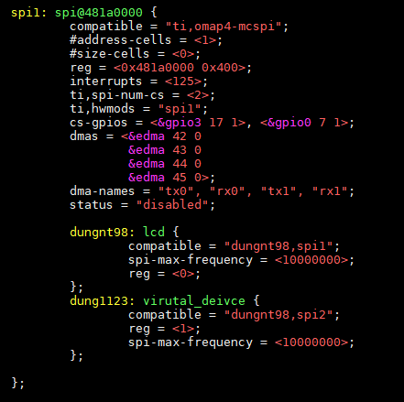
Implement SPI protocol driver
Device tree
Add new device node into Device tree.
Device tree will be parsed when controller driver call to function spi_register_controller

Slide 13
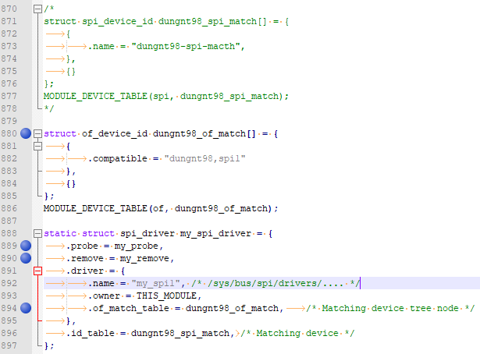
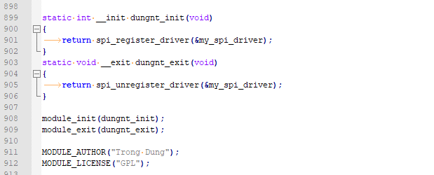
Implement SPI protocol driver
Register struct spi_driver with kernel.
struct spi_driver and struct spi_device

Slide 14
APIs use for SPI protocol driver
#include <linux/spi.h>
spi_setup()
spi_write()
spi_read()
spi_w8r8 - SPI synchronous 8 bit write followed by 8 bit read
spi_w8r16 - SPI synchronous 8 bit write followed by 16 bit read

Slide 15
SPI Controller
Idea: Configuration registers of SPI module
struct platform_driver

Slide 16
Implement SPI Controller
Device tree SPI node
Instance of SPI bus

Slide 17
Device tree
SPI node

Slide 18
Instance of SPI bus
struct spi_master
struct spi_controller

Slide 19
APIs use for SPI controller driver
spi_alloc_master()
omap2_mcspi_master_setup()
spi_master_put()
spi_register_master - register SPI master controller
spi_unregister_controller() - unregister SPI master or slave controller

Slide 20
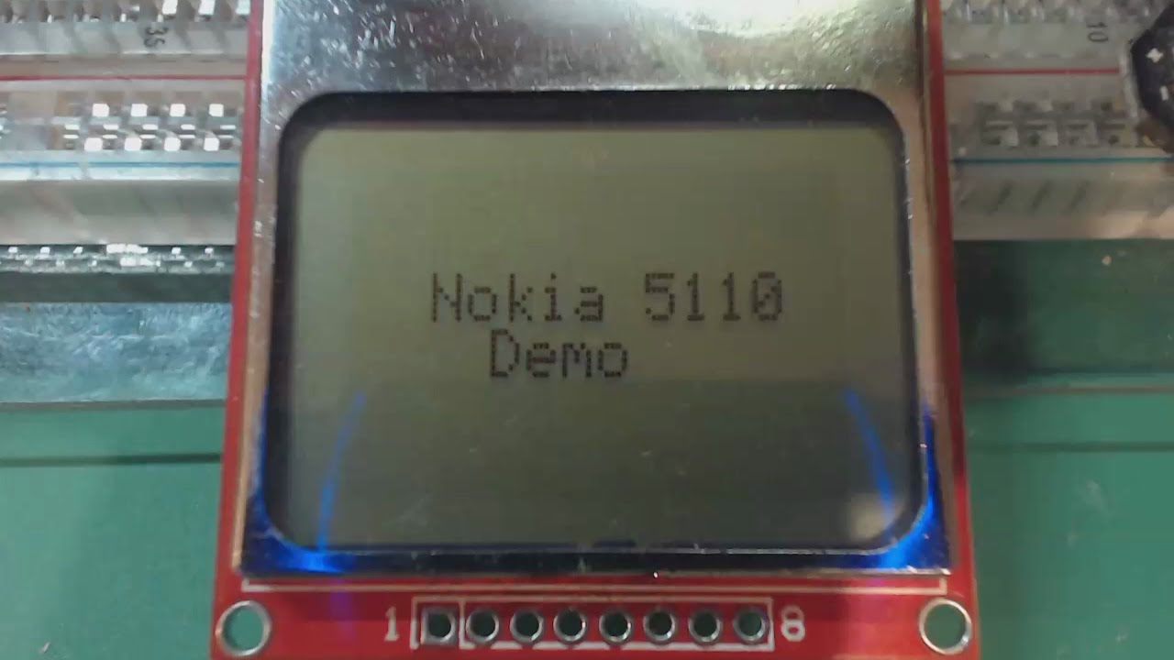
Demo SPI protocol driver with LCD Nokia 5110

Slide 21
Summarize
SPIDEV
SPI protocol driver
struct spi_driver
struct spi_device
SPI controller driver
struct platform_driver
struct spi_master
struct spi_controlle

Slide 22
Thanks for watching

